Slide 1
Individual Homework
Exercise 5.1 – Semantic Tableaux Method
Astăluș Adrian Claudiu

Slide 2
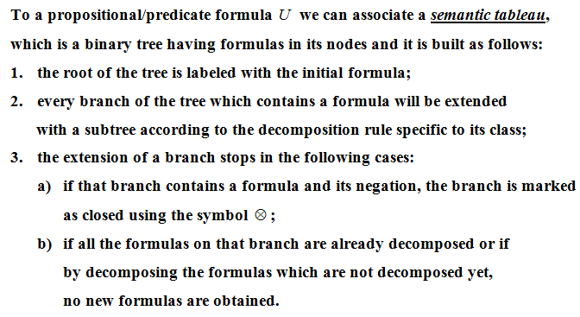

Slide 3
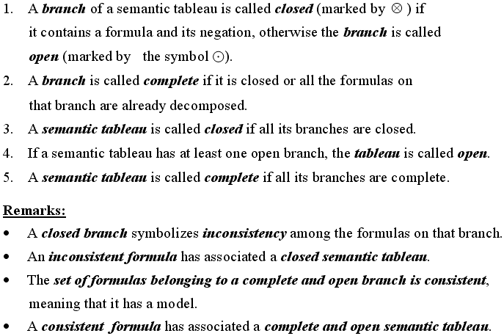

Slide 4
Exercise 5.1 – Using the semantic tableaux method, prove that ‘∃’ is semi-distributive over ‘∧’
We check the distributivity property of ‘∃’ (the existential quantifier) over ‘∧’ (conjunction):
(∃x)(A(x)∧B(x)) ≡ (∃x)A(x)∧(∃x)B(x)
If and only if:
⊨(∃x)(A(x)∧B(x)) ↔ (∃x)A(x)∧(∃x)B(x)
If and only if ⊨U1 and ⊨U2, where:
U1 = (∃x)(A(x)∧B(x)) -> (∃x)A(x)∧(∃x)B(x)
U2 = (∃x)A(x)∧(∃x)B(x) -> (∃x)(A(x)∧B(x))
⊨U if and only if ¬U has a closed semantic tableau (all its branches are closed)
Therefore, we build the semantic tableaux of ¬U1 and ¬U2
For semi-distributivity, we have to prove that U1 is a tautology, and U2 is not a tautology (⊨U1 and ⊭U2)

Slide 5
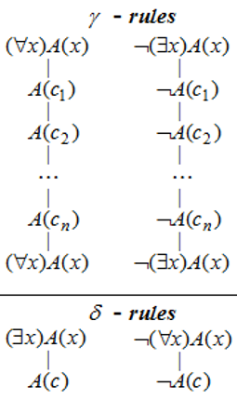
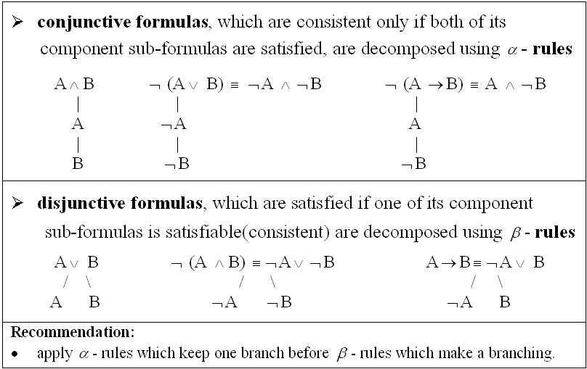
¬U1 = ¬((∃x)(A(x)∧B(x)) -> (∃x)A(x)∧(∃x)B(x)) (1)
| - α – rule for (1)
(∃x)(A(x)∧B(x)) (2)
|
¬((∃x)A(x)∧(∃x)B(x)) (3)
| - δ – rule for (2), c is a new constant
A(c)∧B(c) (4)
| - α – rule for (4)
A(c)
|
B(c)
| - β – rule for (3)
/ \
(7) ¬(∃x)A(x)
¬(∃x)B(x) (6)
γ – rule for (7) |
c used for instantiation
| γ – rule for (6)
c used for instantiation
¬A(c)
Closed branch
ⓧ
¬B(c)
Closed branch
ⓧ
The semantic tableau of ¬U1 is closed, with two closed branches containing pairs of opposite literals: (A(c), ¬A(c)) and (B(c), ¬B(c)), therefore U1 is a tautology (⊨U1 )
|
|
¬(∃x)A(x)
- copy of (7)
¬(∃x)B(x) (9)
- copy of (6)

Slide 6
¬U2 = ¬((∃x)A(x)∧(∃x)B(x) -> (∃x)(A(x)∧B(x))) (1)
| - α – rule for (1)
(∃x)A(x)∧(∃x)B(x) (2)
|
¬((∃x)(A(x)∧B(x))) (3)
| - α – rule for (2)
(∃x)A(x) (4)
|
(∃x)B(x) (5)
| - δ – rule for (4), c1 is a new constant
A(c1)
| - δ – rule for (5), c2 is a new constant
B(c2)
| - γ – rule for (3)
¬((A(c1)∧B(c1)) (6)
|
¬((A(c2)∧B(c2)) (7)
|
¬((∃x)(A(x)∧B(x))) (8) – copy of (3)
| - β – rule for (6)
/ \
¬A(c1)
Closed branch
ⓧ
¬B(c1)
| - β – rule for (7)
There exists an open branch, so ¬U2 doesn’t have a closed semantic tableau and it is not a tautology (⊭U2)
/ \
¬A(c2)
Open branch
⨀
¬B(c2)
Closed branch
ⓧ

Slide 7
Conclusion: We proved that U1 is a tautology (⊨U1), while U2 is not (⊭U2), so the existential quantifier is only semi-distributive over the conjunction
⊨ (∃x)(A(x)∧B(x)) -> (∃x)A(x)∧(∃x)B(x)
and
⊭ (∃x)A(x)∧(∃x)B(x) -> (∃x)(A(x)∧B(x))

